Slide 1
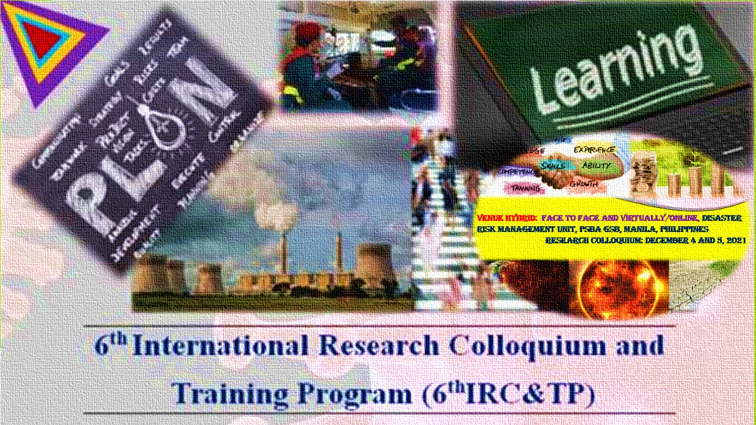









6TH INTERNATIONAL RESEARCH COLLOQUIUM
& TRAINING PROGRAM
October 24, 2021 | 3:00 PM – 5:00 PM Singapore Time
TITLE: Business and Planning
Environment Amidst
COVID-19 Pandemic
December 4 to 5, 2021

